Slide 1
COVID DATASET

Slide 2
EXECUTIONS ON DATASET
Shows likelihood of a person would be died in case of she has been infected?
Shows likelihood of a person would be died in case of she has been vaccinated?
Shows likelihood of a person would be infected in case of she has been vaccinated?
Which country does have the highest death rate compare to population?

Slide 3
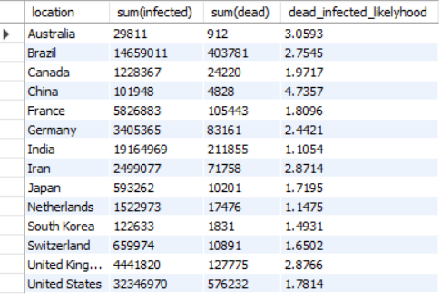
Shows likelihood of a person would be died in case of she has been infected?
select location, sum(infected), sum(dead), (sum(dead)/sum(infected)*100) as dead_infected_likelihood from covid group by location order by dead_infected_likelyhood;

Slide 4
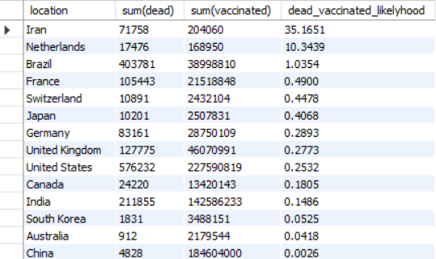
Shows likelihood of a person would be died in case of she has been vaccinated?
select location,sum(dead), sum(vaccinated), (sum(dead)/sum(vaccinated)*100) as dead_vaccinated_likelyhood from covid group by location order by dead_vaccinated_likelyhood desc;

Slide 5
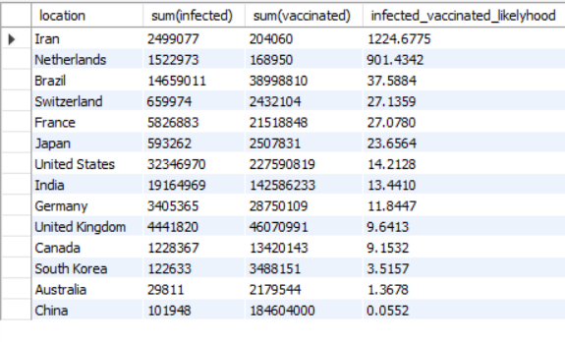
Shows likelihood of a person would be infected in case of she has been vaccinated?
select location, sum(infected), sum(vaccinated),(sum(infected)/sum(vaccinated)*100) as infected_vaccinated_likelyhood from covid group by location order by infected_vaccinated_likelyhood desc;

Slide 6
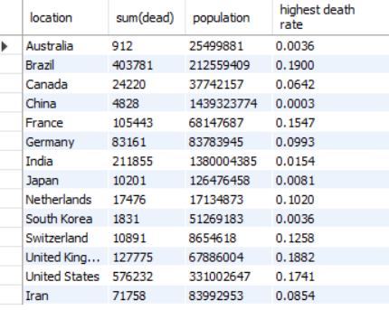
Which country does have the highest death rate compare to population?
select location, sum(dead), population, (sum(dead)/population*100) as 'highest death rate' from covid group by location, population order by 'highest death rate' desc;

Slide 7

THANK YOU

